Slide 1
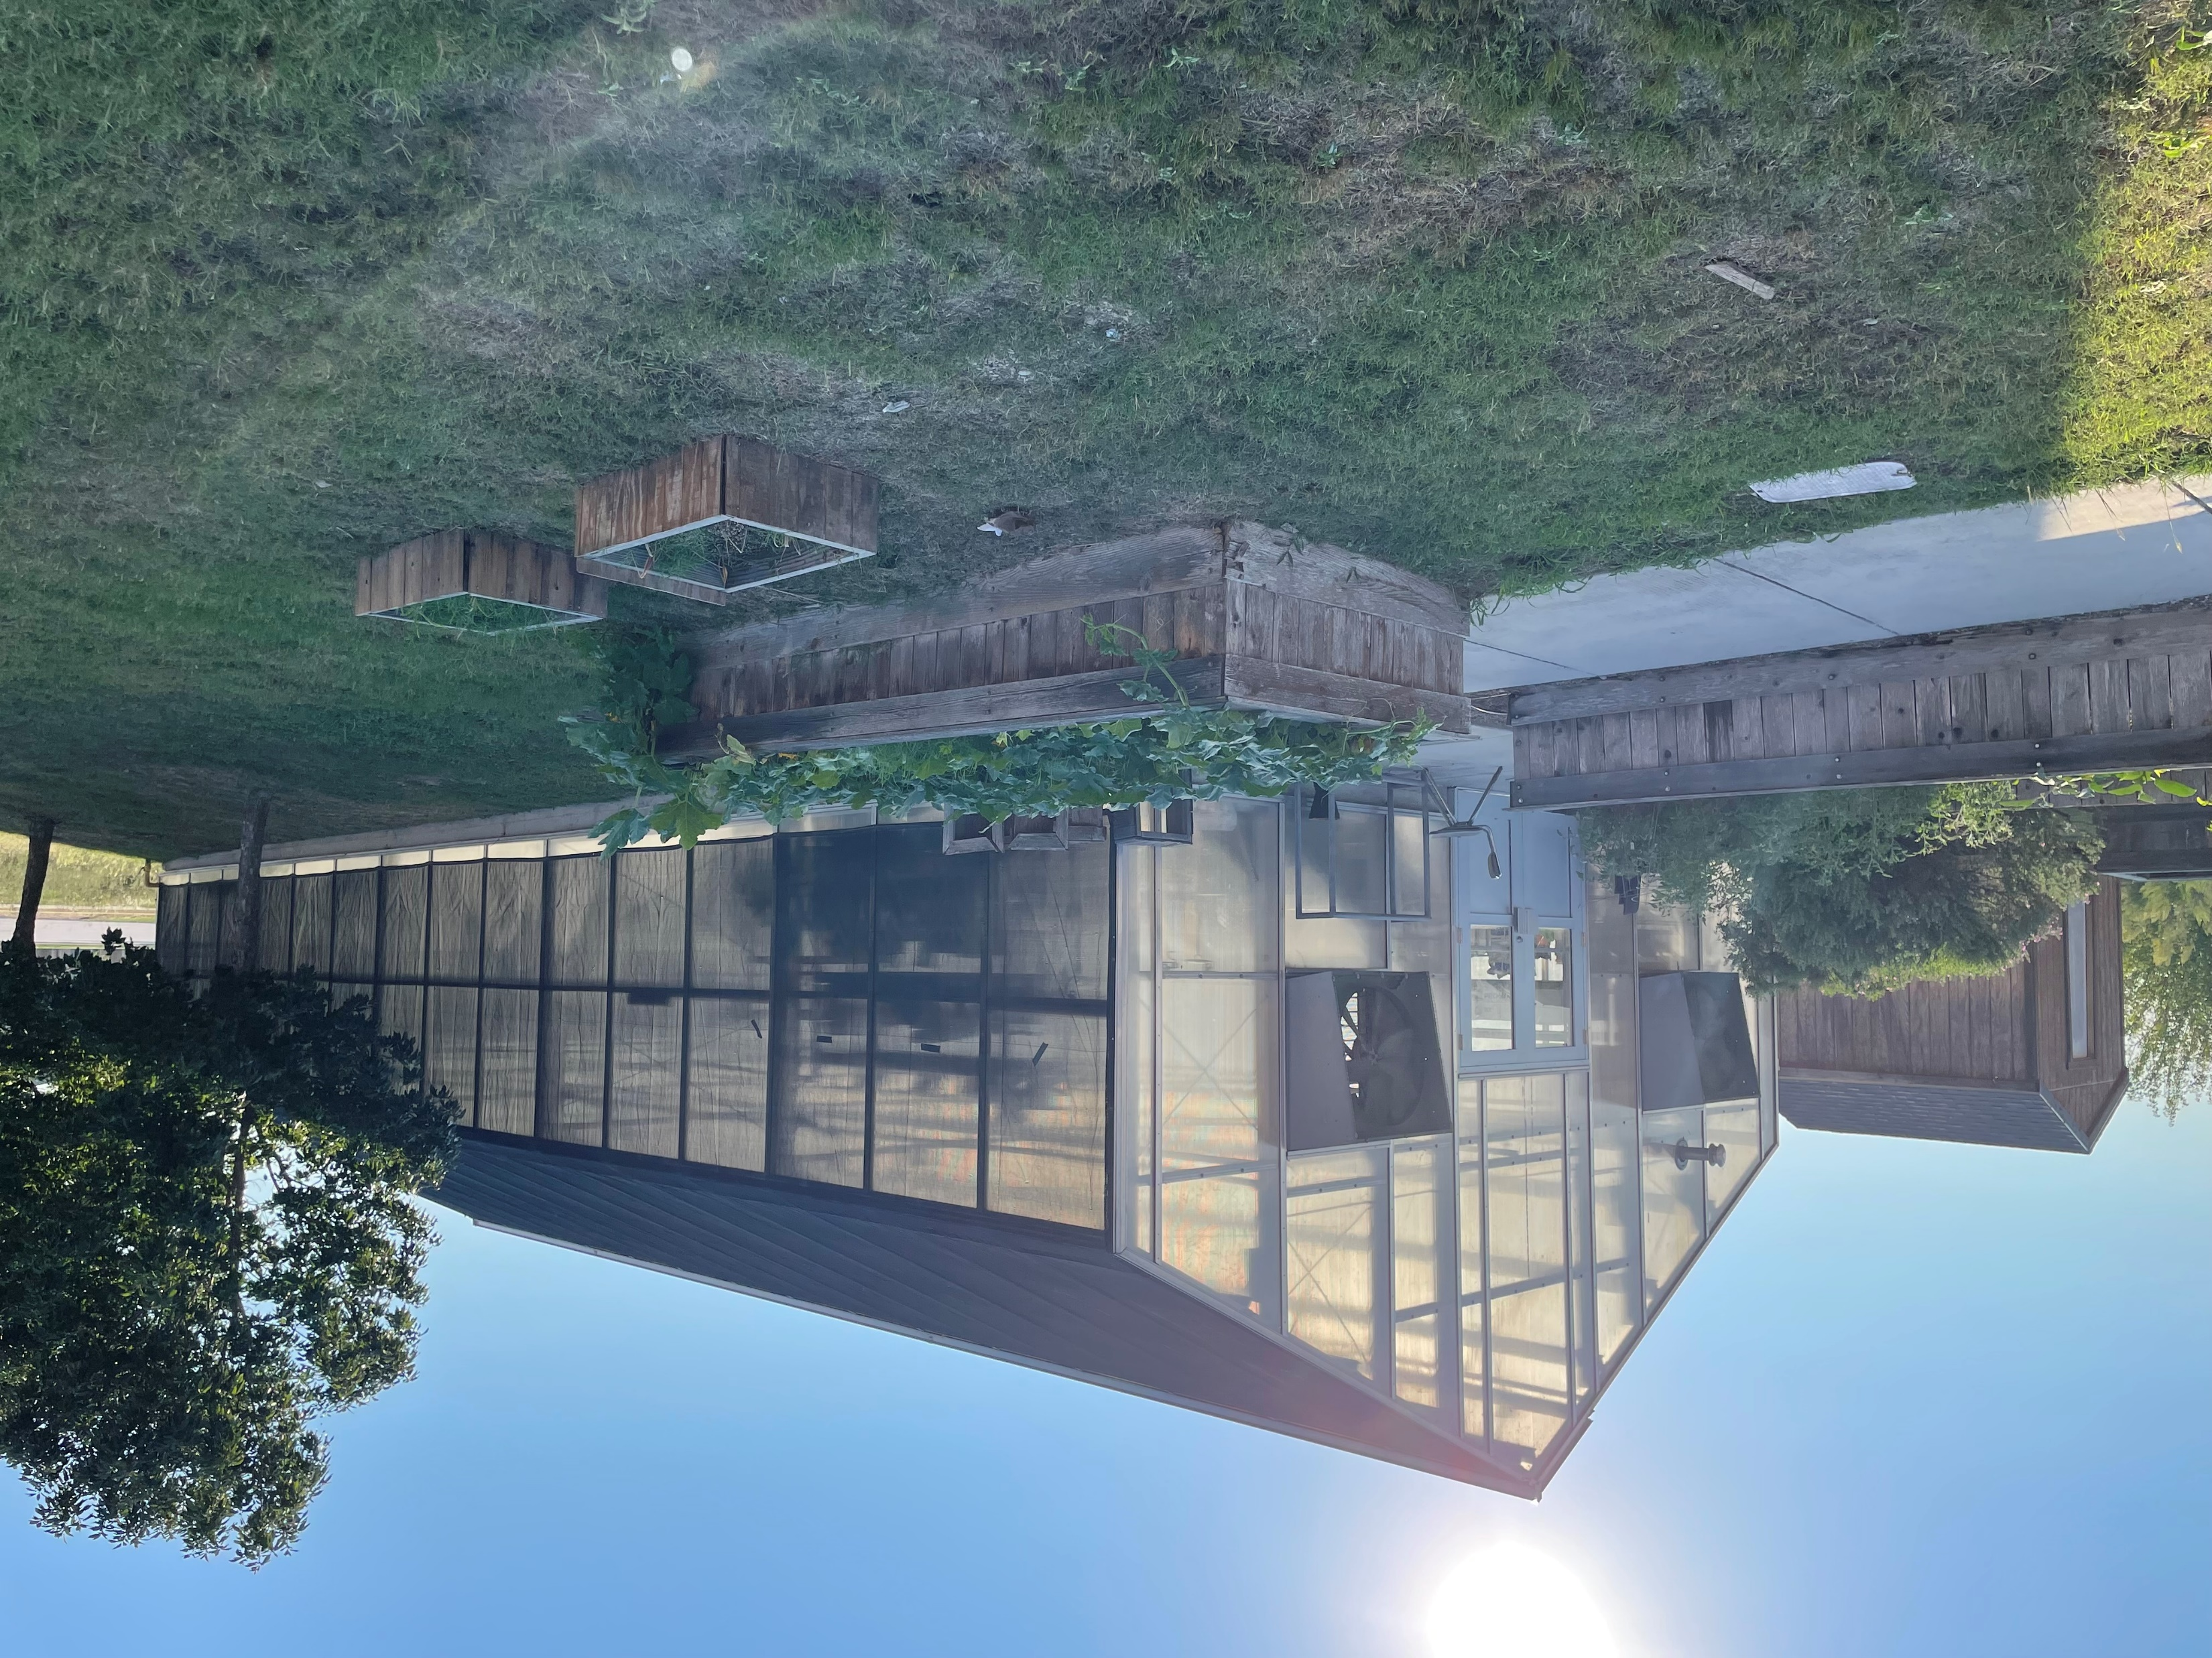
Plant Science
Statewide Program of Study
Agriculture, Food, and Natural Resources Career Cluster
The Agriculture, Food, and Natural Resources (AFNR) Career Cluster focuses on the essential elements of life - food, water, land, and air. This career cluster includes a diverse spectrum of occupations, ranging from farmer, rancher, and veterinarian to geologist, land conservationist, and florist. It also includes non-traditional agricultural occupations like wind energy, solar energy, and oil and gas production.
The Plant Science program of study focuses on the science, research, and business of plants and other living organisms. It teaches students how to apply biology and life science to real-world life processes of plants and vegetation, either in laboratories or in the field.
Secondary Courses for High School Credit
1 Principles of Agriculture, Food, and Natural Resources
2 Floral Design
3 Advanced Floral Design
4 Advanced Plant and Soil Science
OR
Greenhouse Operation and Production
Work-Based Learning and
Expanded Learning Opportunities
Exploration Activities | Work-Based Learning Activities
Participate in Texas FFA | Work at a florist or landscaper business Participate in an FFA supervised agriculture experience
Industry-Based Certifications
Principles of Floral Design Certification
Texas State Florist's Association Level I Floral Certification
Postsecondary Opportunities
Associates Degrees
Applied Horticulture/ Horticulture Operations, General
Ornamental Horticulture
Agricultural Business and Management, General
Turf and Turfgrass Management
Bachelor’s Degrees
Applied Horticulture/ Horticulture Operations, General
Agronomy and Crop Science
Agricultural Business and Management, General
Turf and Turfgrass Management
Master’s, Doctoral, and Professional Degrees
Applied Horticulture/ Horticulture Operations, General
Agronomy and Crop Science
Agricultural Business and Management, General
Farm/Farm and Ranch Management
SMHS Greenhouse
Aligned Occupations
Occupations | Median Wage | Annual Openings | % Growth
Soil and Plant Scientists | $54,662 | 116 | 21%
Tree Trimmers and Pruners | $32,240 | 589 | 14%
Pesticide Handlers, Sprayers, and Applicators | $36.733 | 196 | 22%
Landscaping Supervisors | $44,408 | 807 | 19%
Biological Technicians | $42,931 | 452 | 17%
Successful completion of the Plant Science program of study will fulfill requirements of a Business and Industry endorsement or STEM endorsement if the math and science requirements are met. Revised – August 2022

Slide 2
Plant Science Course information
COURSE NAME | SERVICE ID | PREREQUISITES | COREQUISITES
Principles of Agriculture, Food, and Natural Resources | 13000200 (1 credit) 6100 | None | None
Floral Design | 13001800 (1 credit) 6140 | None | None
Advanced Floral Design | N1300270 (1 credit) 6141 | Floral Design | None
Advanced Plant and Soil Science | 13002100 (1 credit) 6131 | Advanced Floral Design | None
Greenhouse Operation and Production | 13002060 (2 credits) 6145 | Advanced Floral Design | None
FOR ADDITIONAL INFORMATION ON THE AGRICULTURE, FOOD, & NATURAL RESOURCES CAREER CLUSTER,
PLEASE CONTACT: CJ Odam, SMCISD CTE Coordinator cj.odam@smcisd.net
San Marcos CISD does not discriminate on the basis of race, color, national origin, sex, disability or age in its programs or activities and provides equal access to the Boy Scouts and other designated youth groups. The following person has been designated to handle inquiries regarding the nondiscrimination policies: Stephanie Munoz ; 631 Mill St, San Marcos, TX 78666 ; 512-393-6700 ; stephanie.munoz@smcisd.net
Further nondiscrimination information can be found at smcisd.net/cte

